Slide 1

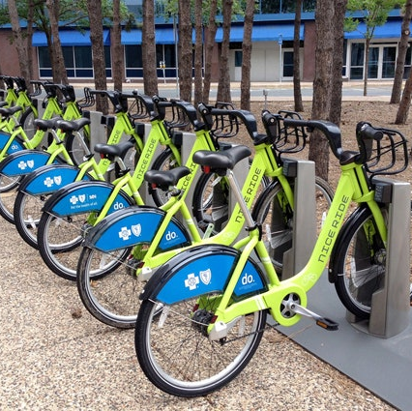
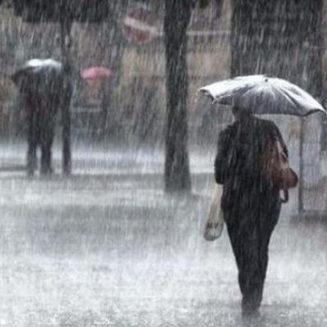

Predicting Hourly Bike Sharing Rentals
Abigail Glisson
Sunday, September 4, 2022
Final Project Presentation
ENTITY Data Science Virtual Academy

Slide 2

Abi Glisson
ENTITY Academy Education Specialist
Currently working at ENTITY
Former High School science and math teacher
Education
Data Science Certificate, ENTITY Academy
Master of Education, Harvard Graduate School of Education
Bachelor of Civil Engineering, Georgia Institute of Technology

Slide 3

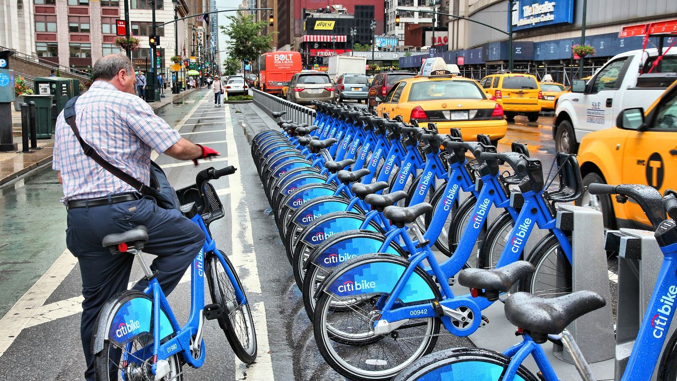

Introduction
Bike Sharing services have become increasingly popular in recent years.
This project seeks to predict how many bikes will be rented in a given hour based on several factors.

Slide 4


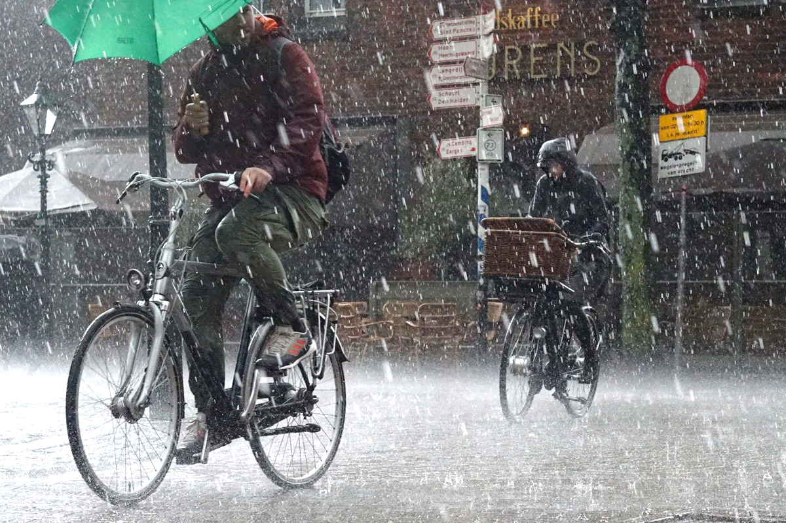
Evaluation Question
Given information about date, season, weather, day of the week, and whether a day is a holiday, weekend, or work day, how many bikes will be rented in a particular hour?
Notes:
Although the LMS prompts us to answer at least 2 Evaluation Questions, we were assigned only 1 Evaluation Question by Dr. Mo.

Slide 5
Methods

Slide 6

Data Selection
Dataset assigned to small group from cohort
Hourly bike sharing rentals counts
Including variables about weather, season, and whether the day was a holiday, work day, or weekend
Data spanned all of 2011 and 2012
Do not have geographic information about where the data were collected

Slide 7

Date-Related Independent Variables
`dteday`: date
`yr`: year (`0`: 2011, `1`: 2012)
`mnth`: month (1 to 12)
`hr`: hour (0 to 23)
`holiday`: whether day is holiday (`1`) or not (`0`)
`weekday`: day of the week (`0`: Sunday through `6`: Saturday)
`workingday`: if day is neither weekend nor holiday is `1`, otherwise is `0`

Slide 8

Weather-Related Independent Variables
`season: season
`1`: winter
`2`: spring
`3`: summer
`4`: fall
`weathersit`: weather situation
`1`: Clear, Few clouds, Partly cloudy, Partly cloudy
`2`: Mist + Cloudy, Mist + Broken clouds, Mist + Few clouds, Mist
`3`: Light Snow, Light Rain + Thunderstorm + Scattered clouds, Light Rain + Scattered clouds
`4`: Heavy Rain + Ice Pallets + Thunderstorm + Mist, Snow + Fog
`temp`: Normalized temperature in Celsius
`atemp: Normalized feeling temperature in Celsius
`hum`: Normalized humidity
`windspeed`: Normalized wind speed
NOTE: Weather values are already NORMALIZED.

Slide 9

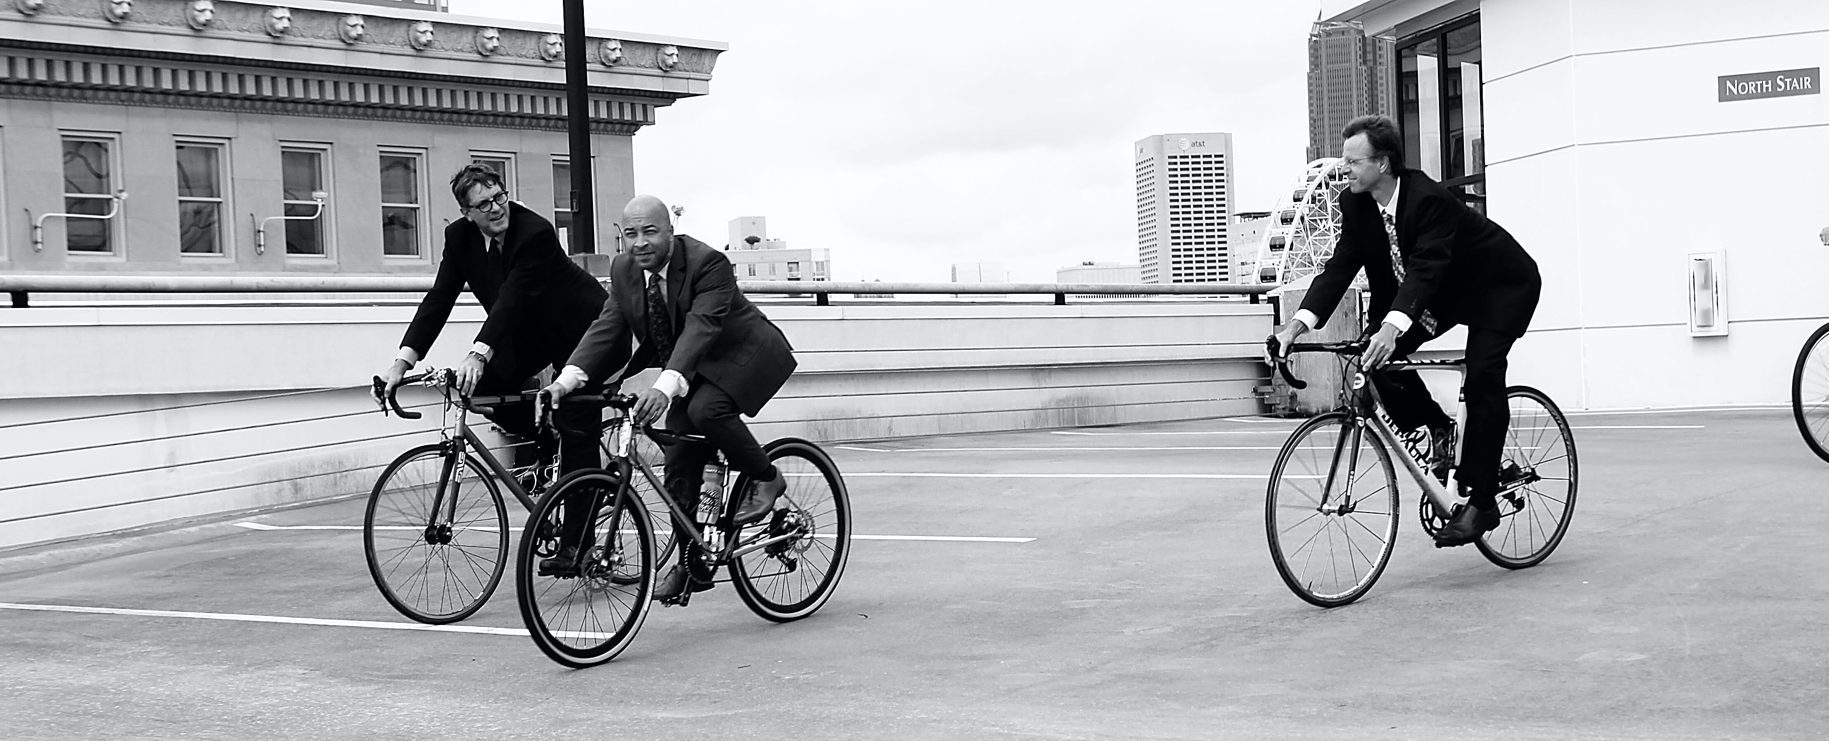
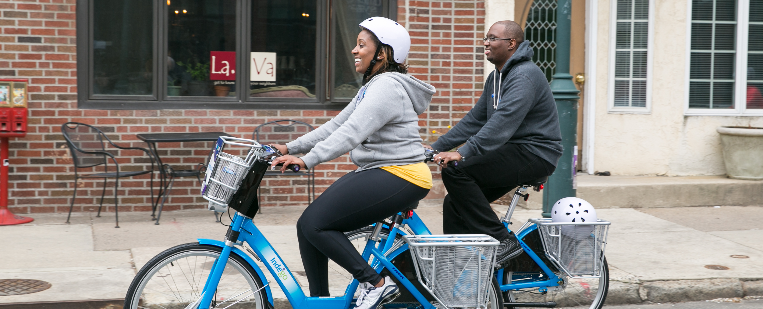
Potential Dependent Variables
`casual`: count of casual users
`registered`: count of registered users
`cnt`: count of total rental bikes = sum of casual and registered

Slide 10
Data Wrangling
Given dataset was very complete – no null or NaN values to begin with
17,379 observations → PLENTY of data to analyze!
Continuous variables given as already-normalized to a scale of 0 to 1
PRO: preferable for machine learning algorithms
CON: not much physical meaning to us
Not much extraneous data to handle
Certain variables dropped at different times for different purposes – e.g., `cnt` vs ` registered` vs `casual`
`instant` ultimately not needed

Slide 11
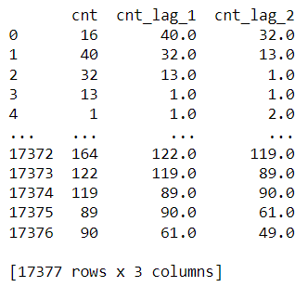
New Variables
Categorical variables with more than 2 levels → dummy coded
Created two new variables – “lag” variables which essentially used the rentals of the past 1 and 2 hours to predict the current hour

Slide 12
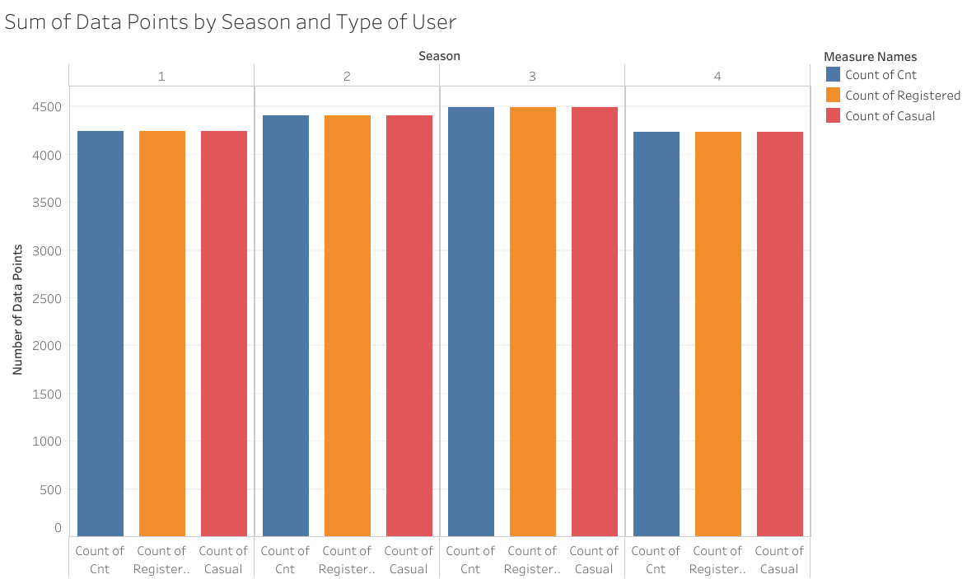
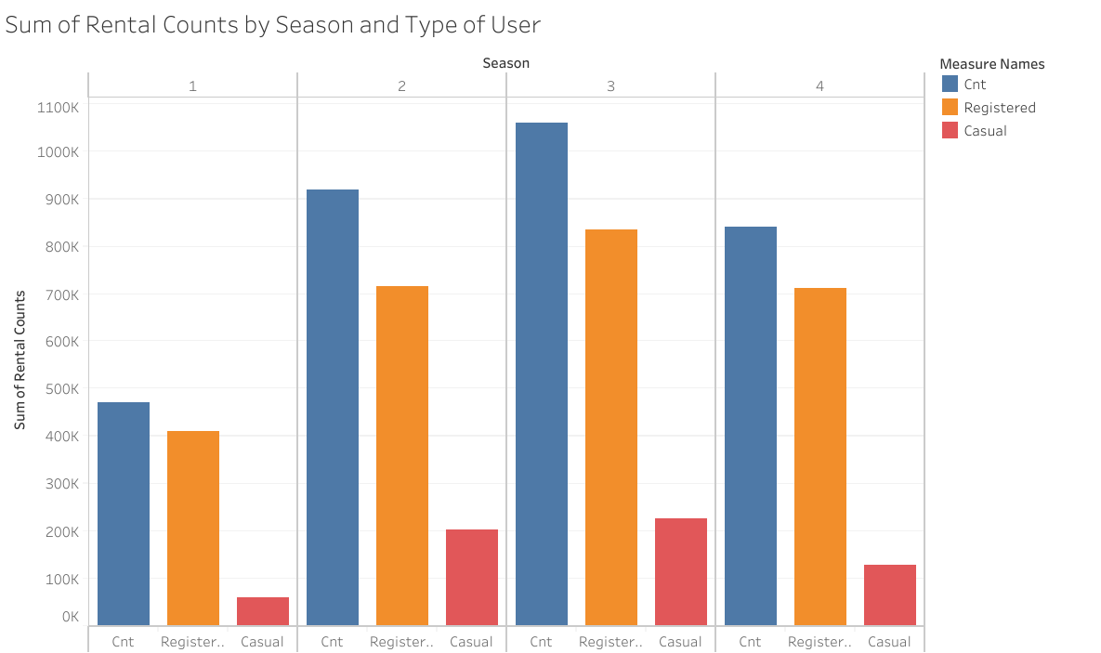
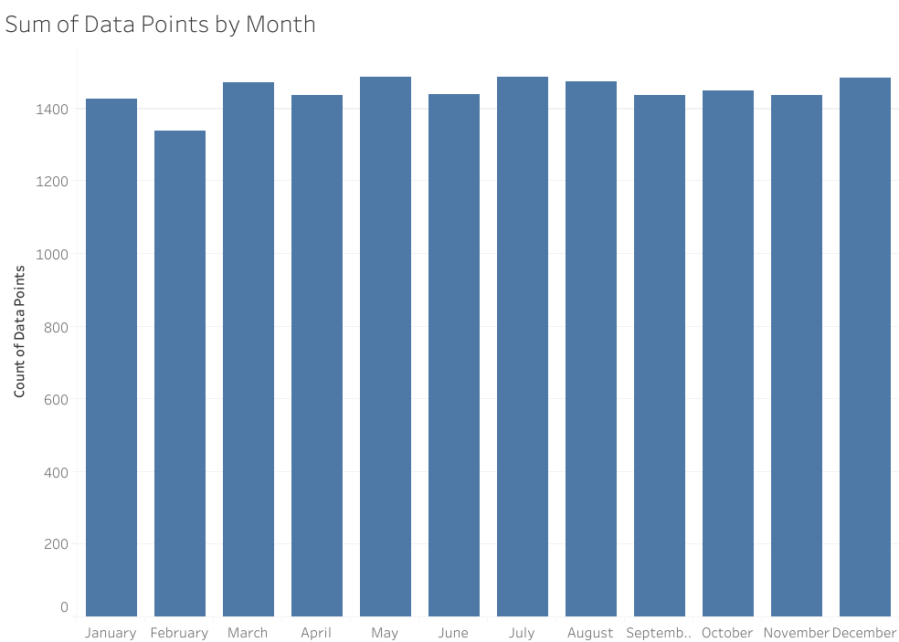
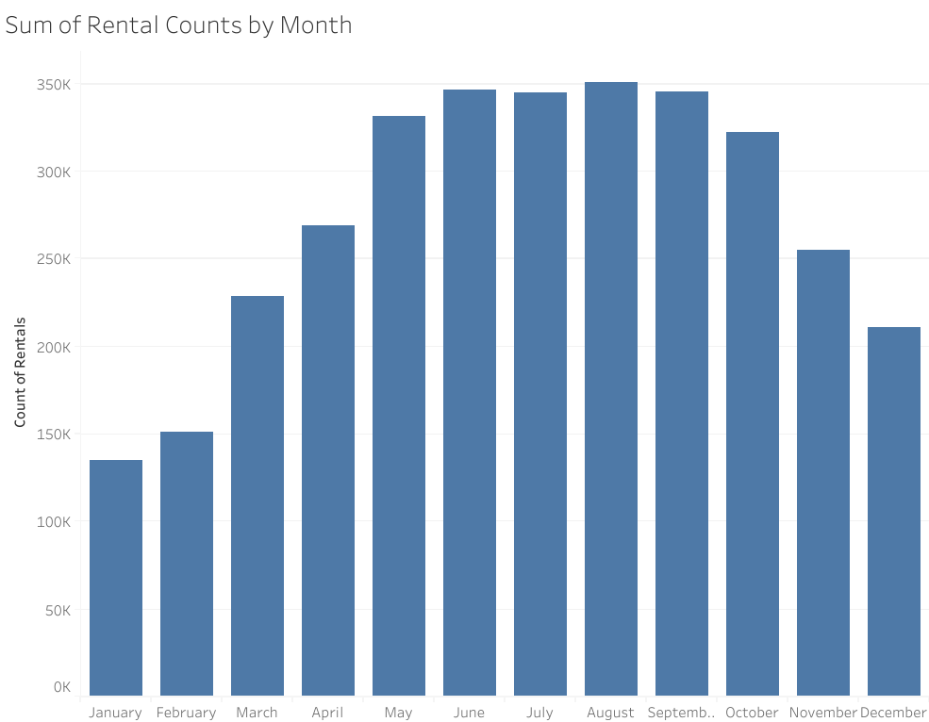
Summary Statistics
Weather data summaries omitted – normalized doesn’t have physical meaning for us
Total data points
Original data set: 17,379
Lag-variable data set: 17,377
Data collected nearly every hour for two years
Evenly distributed COUNTS of data points
Variation in rental counts still evident

Slide 13
Summary of Dependent Variables
 | Casual | Registered | Total
Mean | 35.7 | 153.8 | 189.5
Minimum | 0 | 0 | 1
Median | 17 | 115 | 142
Maximum | 48 | 886 | 977
Std. Dev. | 49.3 | 151.4 | 181.4

Slide 14
Descriptive Visualization
Results

Slide 15
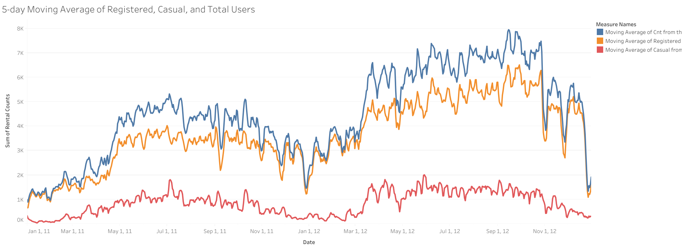
Moving Average of Rental Counts by Date

Slide 16
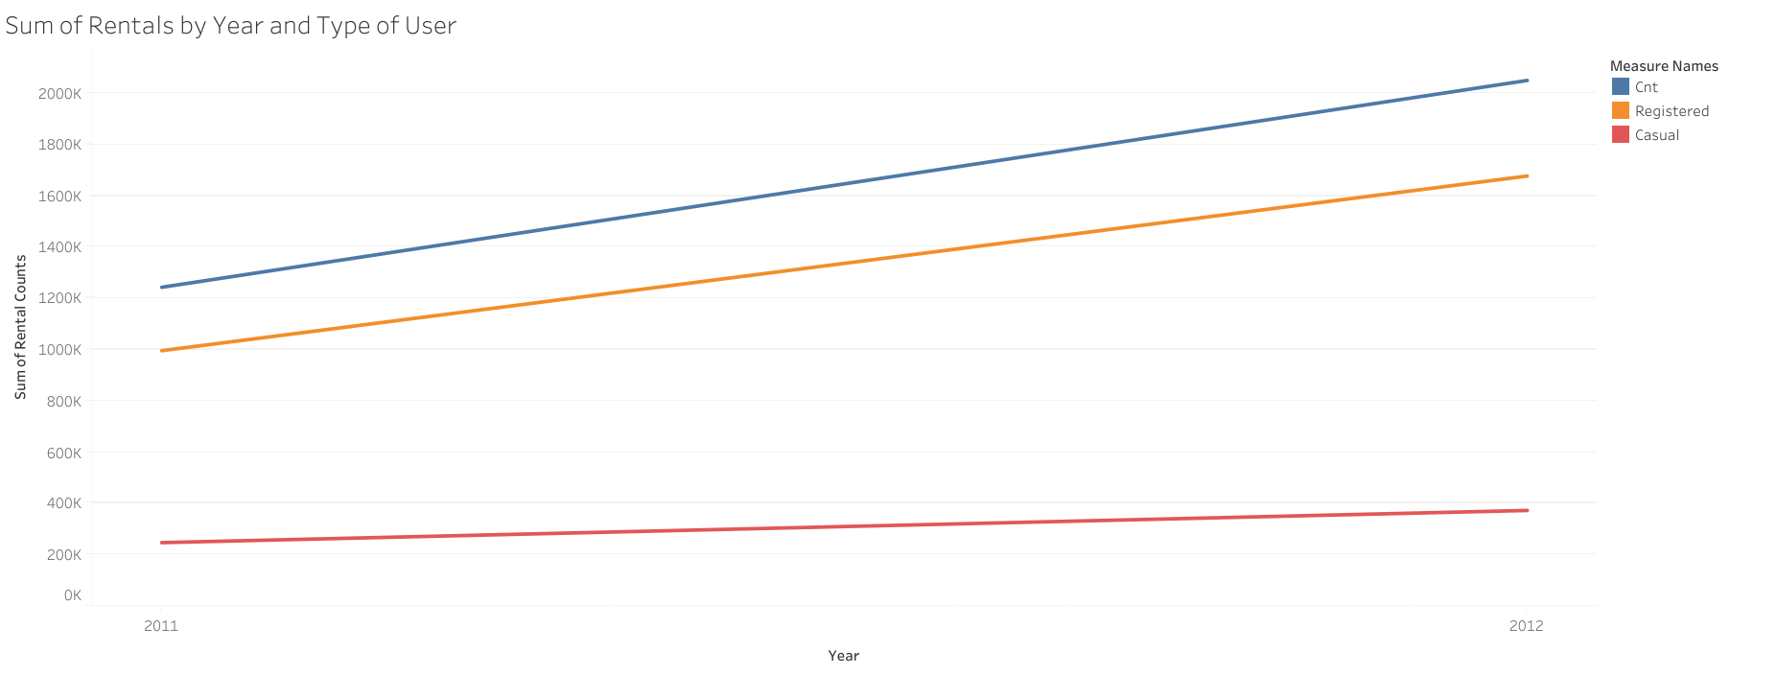
Rental Counts by Year and Type of User

Slide 17
Rental Counts by Season and User Type
1: Winter
2: Spring
3: Summer
4: Fall

Slide 18
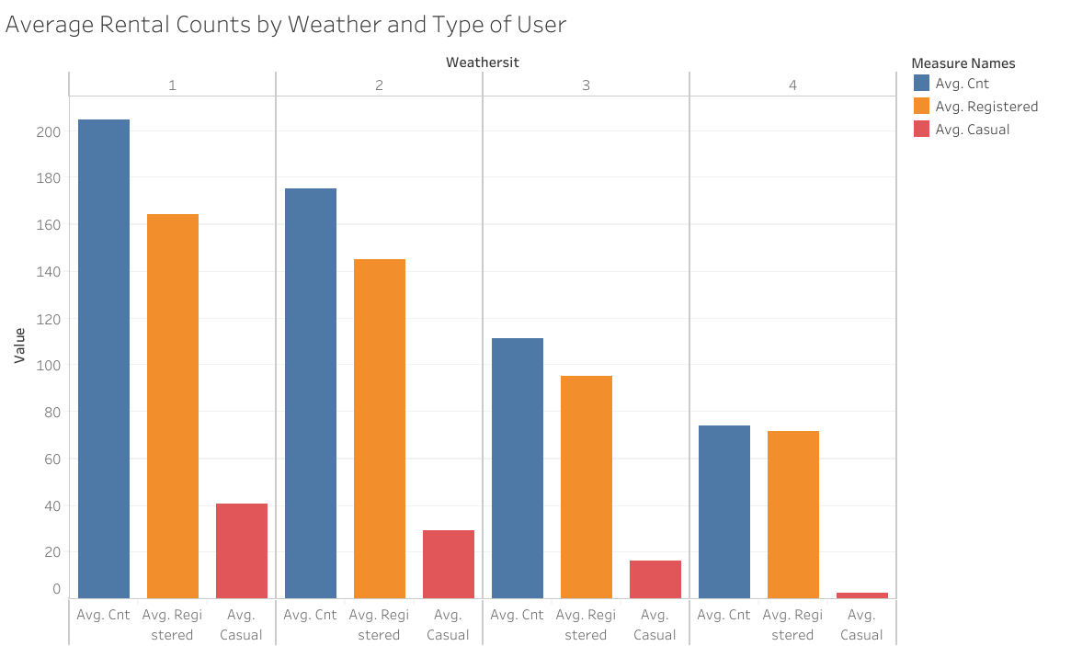
Rental Counts by Weather and User Type
`1`: Clear, Few clouds, Partly cloudy, Partly cloudy
`2`: Mist + Cloudy, Mist + Broken clouds, Mist + Few clouds, Mist
`3`: Light Snow, Light Rain + Thunderstorm + Scattered clouds, Light Rain + Scattered clouds
`4`: Heavy Rain + Ice Pellets + Thunderstorm + Mist, Snow + Fog

Slide 19
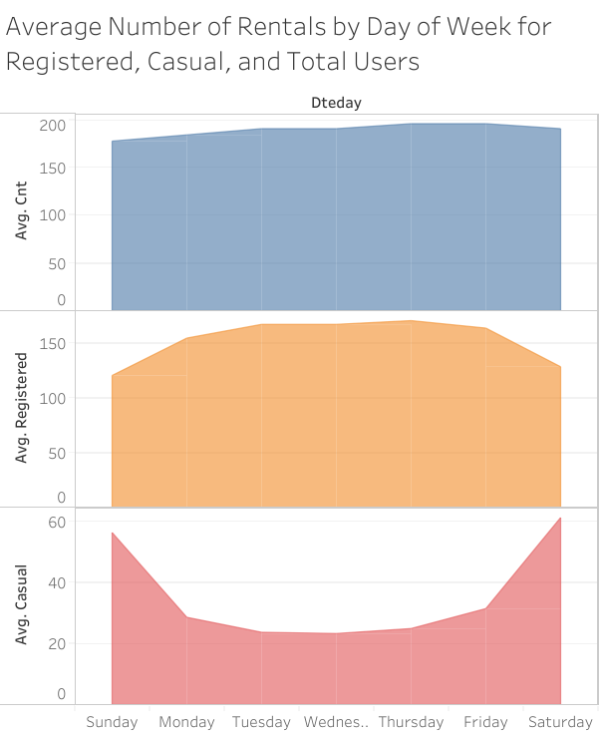
Average Rental Counts by Day of Week and User Type

Slide 20
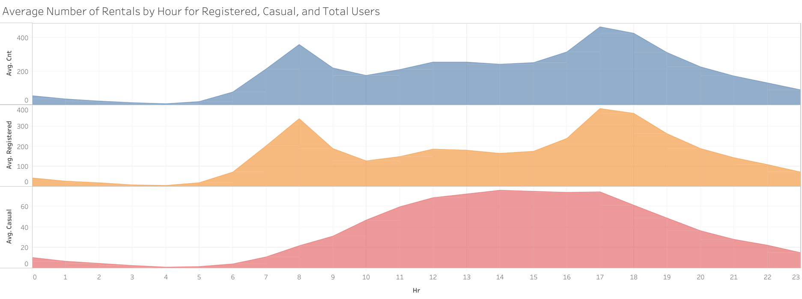
Average Rental Counts by Hour of the Day and User Type

Slide 21
Machine Learning
Results

Slide 22
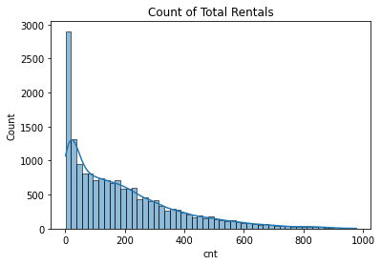
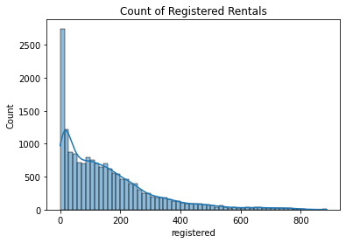
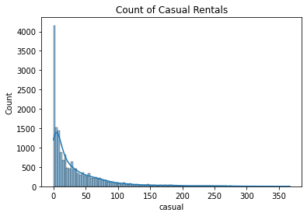
Assumptions
PLENTY of Observations for any type of analysis
Basic Histograms reveal we have highly non-parametric data – similar distributions for each type of user.

Slide 23
Model Selection
We have the actual values for the dependent variable we want to predict → Supervised ML
Non-Parametric Distribution with both continuous and categorical independent variables → Random Forest
Seeking to predict a Continuous variable → use Random Forest Regressor, not Classifier

Slide 24
Split Data into Training and Testing Sets
These data are inherently time-based → use the “past” to predict the “future” (rather than random splitting)
With 24 months of data, using the first 18 months of data to predict the last 6 months of results would give us a 75/25 split.
Training set: January 1, 2011 to June 30, 2012
Testing set: July 1, 2012 to December 31, 2012

Slide 25
Hyperparameter Tuning
With a Random Forest Regression, we must tell Python how many trees, leaves, samples, etc. that it should use. But, how do we know which parameters to use without testing every single variation?
Process:
Create a dictionary of the common possibilities for the various hyperparameters.
Use a Randomized Search cross validation to test 100 different combinations of hyperparameters, each with 5-fold cross-validation (500 total trials!)
Call the best parameters for the Randomized Search and re-fit your model using those hyperparameter settings
Results:
Number of estimators: 402
Minimum sample split: 5
Minimum sample leaf: 2
Maximum depth: 7
Bootstrap: True

Slide 26

Initial Random Forest
Using all original independent variables (minus `instant`, `dteday`, and `atemp`), the mean cross-validation score for predicting the `cnt` variable is 67.5%
That’s good, but can we do better?

Slide 27
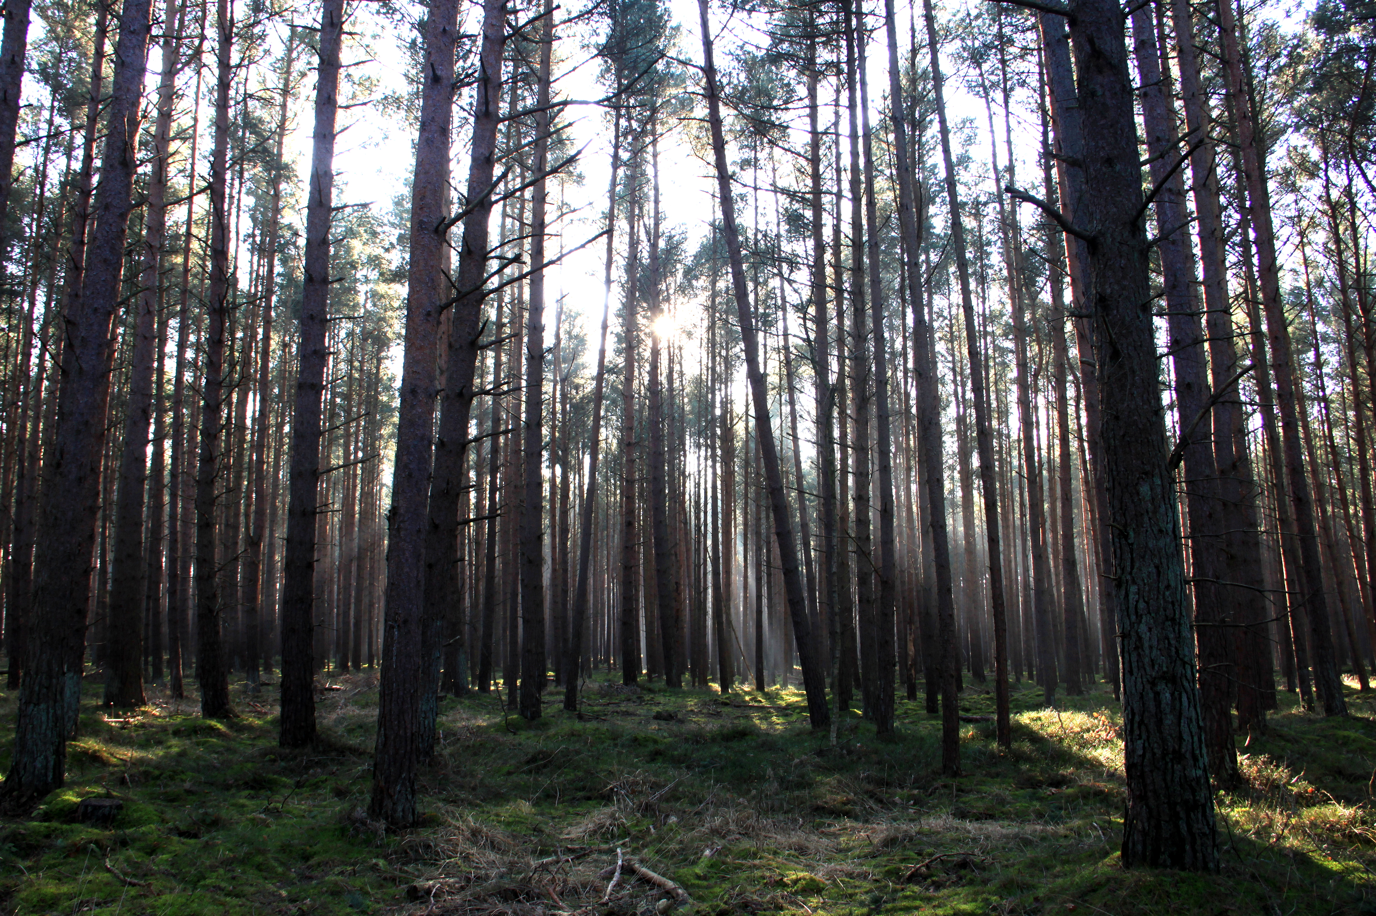
Random Forest with Lag Variables
Create 2 additional variables that shift the `cnt` variable by 1 and 2 hours – i.e., use the last 1 and 2 hour counts to predict the current hour
Using all original independent variables (minus `instant`, `dteday`, and `atemp`), plus two lag variables, the mean cross-validation score for predicting the `cnt` variable is 89.3%
That’s great, but can we do better? Perhaps the registered and casual users behave differently!

Slide 28
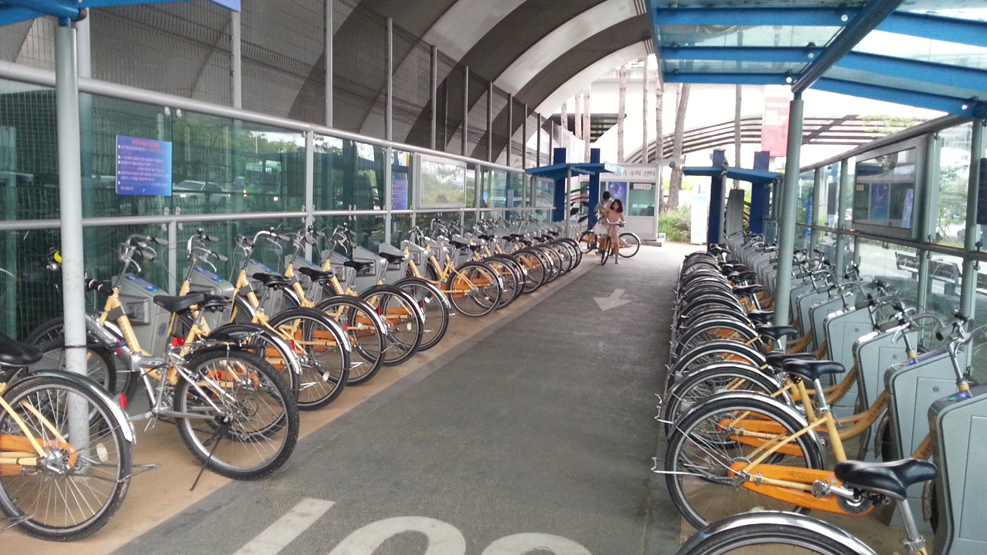
RF with Lag Variables to Predict Registered User Rentals
Using all original independent variables (minus `instant`, `dteday`, and `atemp`), plus two lag variables, the mean cross-validation score for predicting the `registered` variable is 99.7%
That’s great, but does the same level of prediction hold up for Casual users?
This Photo by Unknown Author is licensed under CC BY-NC

Slide 29
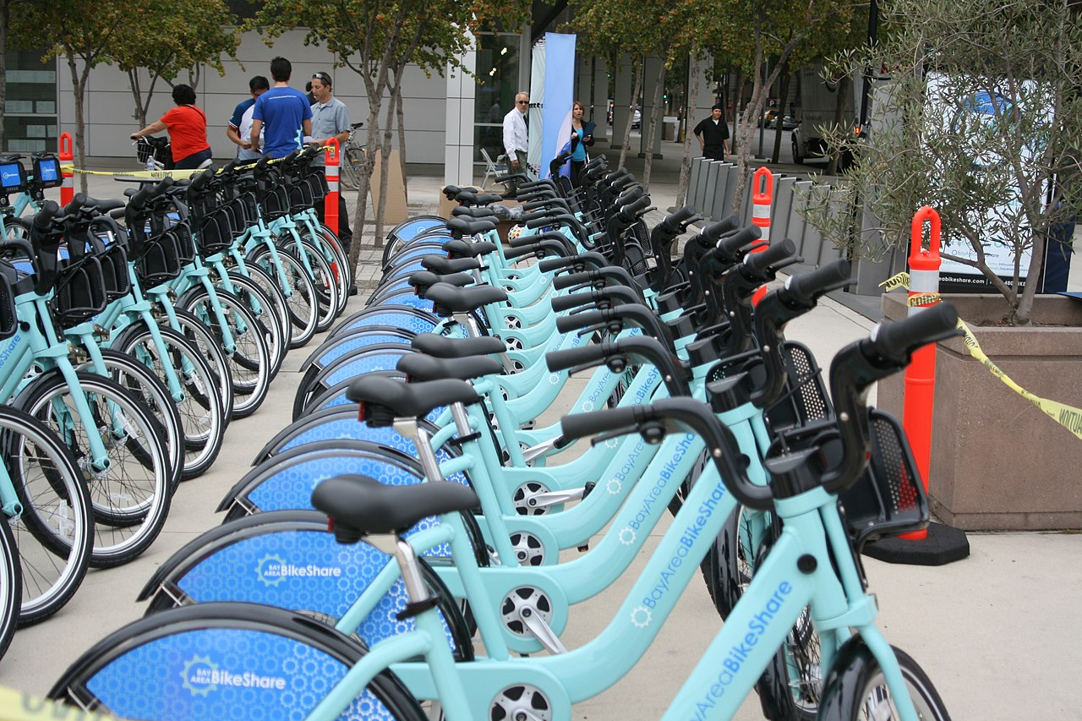
RF with Lag Variables to Predict Casual User Rentals
Using all original independent variables (minus `instant`, `dteday`, and `atemp`), plus two lag variables, the mean cross-validation score for predicting the `casual` variable is 99.7%
Wow!

Slide 30
Summary & Conclusions

Slide 31

Summary
Using tuned hyperparameters and by fitting the Registered and Casual user rental counts separately, the Random Forest Regression can predict hourly rental counts with 99.7% accuracy.

Slide 32
Conclusion
The addition of calculated lag variables significantly increases the model accuracy – in other words, the number of rentals in the previous 1 and 2 hours heavily influences the number of rentals there will be in the current hour.
Calculating the Registered and Casual user counts separately produces more accurate results than predicting the combined total rental Count
This makes sense as Registered and Casual users may have different behavioral priorities.

Slide 33


Questions?
Abigail Glisson
arnglisson@gmail.com
https://github.com/aglisson6/ENTITY-Data-Science-Virtual-Academy-Final-Project

